Slide 1
Recording in session
Notes:
Press the Record button.
This virtual session is being recorded.

Slide 2
Mid-year update and funding
2024-2027 Three-Year LCAP Development
LCAP | Educational Partner Engagement | January 19, 2024

Slide 3
Recording in session
Notes:
Press the Record button.
This virtual session is being recorded.

Slide 4
Welcome
Welcome / Opening
Superintendent Dr. Michelle Rodriguez
English: https://www.stocktonusd.net/cms/lib/CA01902791/Centricity/Domain/142/SUSD%20State%20of%20the%20District%202023%20-%20English.pdf
Spanish:
https://www.stocktonusd.net/cms/lib/CA01902791/Centricity/Domain/142/SUSD%20State%20of%20the%20District%202023%20-%20Spanish.pdf
https://www.stocktonusd.net/Page/17757

Slide 5
NEW RELEASE
“ALL OF SUSD” Dashboard
www.allofsusd.net

Slide 6
AGENDA
Mid-Year Update and Funding
Topics:
LCAP Engagement In 2023-2024
LCAP and SUSD Guiding Principles
Prior Engagement Session Recap
Opportunities to Build Trust Through Authentic Engagement
Mid-Year Update
Funding Overview
Next LCAP Engagement Session

Slide 7
LCAP Engagement in 2023-2024
11/28: Introduction: LCAP Fundamentals
12/04: Current District Priorities – 2023-2024 School Year
01/19: LCAP Mid-Year Update and Funding
02/09: Data Analysis / District Areas of Need
02/19: Budget Projections
03/05: Survey Results and Key Findings
03/08: Identified District Goals/Activities
* April 2024: Post Draft 2024-2027 LCAP
* May 2024: Public Hearing 2024-2027 LCAP
* June 2024: Board Adoption 2024-2027 LCAP

Slide 8
LCAP and SUSD Guiding principles
IMPROVING
STUDENT
OUTCOMES

Slide 9
LCAP Guiding Principles
Transparency in SUSD
Inclusive communication and information to support decisions.
Equity in SUSD
Supporting students not on what is fair or equal, but equitable.
Subsidiarity in SUSD
Lowest level of decision-making, which is based on data and identified needs with input from educational partners.

Slide 10
JOY, TRUST, and Belief: Pillars of Success for SUSD
1 interaction
1 decision
1 day at a time
https://youtu.be/XKgMskwgHog?si=oyddC_MLMpyR2w29

Slide 11
Think time
Happy New Year!
Question 1:
As an Educational Partner, what Resolution/Commitment would you make or reaffirm supporting your student’s education?
2 minutes to Post your comment(s)
in the chat box.

Slide 12
Prior engagement session recap
CIRCLING
BACK

Slide 13
Prior engagement session topics
Topics Presented:
LCAP Requirements and Components
LCAP Development
LCAP Lifecycle
LCAP Requirements
Educational Partners
LCAP Approval Process
Local Control Funding Formula
LCAP and School Plan for Student Achievement (SPSA) Alignment
Connecting 2023-2024 District Priorities
Missed the Session?
SUSD recorded the Zoom LCAP Engagement Session for post meeting review at your convenience.
These recordings and the presentations are available on the district’s LCAP webpage: https://www.stocktonusd.net/Page/16289
The district’s current (and past) LCAP is available too.

Slide 14
Opportunities to build trust Through Authentic Engagement
Joining Together to Create a Bold Vision for
Next Generation Family Engagement
Engaging Families to Transform Education
Carnegie Corporation of New York
https://media.carnegie.org/filer_public/f8/78/f8784565-4bd6-4aa3-bd80-2b98fd43380e/parent-engagement-2018.pdf

Slide 15
Family engagement specialists
WELCOME!
Student Support Services
Dr. Susana Ramirez, Assistant Superintendent Student Support Services
Priscilla Anguiano
Claudia Cartagena
Jessica Griffin-Brown
Local Control Accountability Plan (LCAP) & School Site Council (SSC)
Parent Advisory Committees (PACs)
Rosie Fernandez

Slide 16
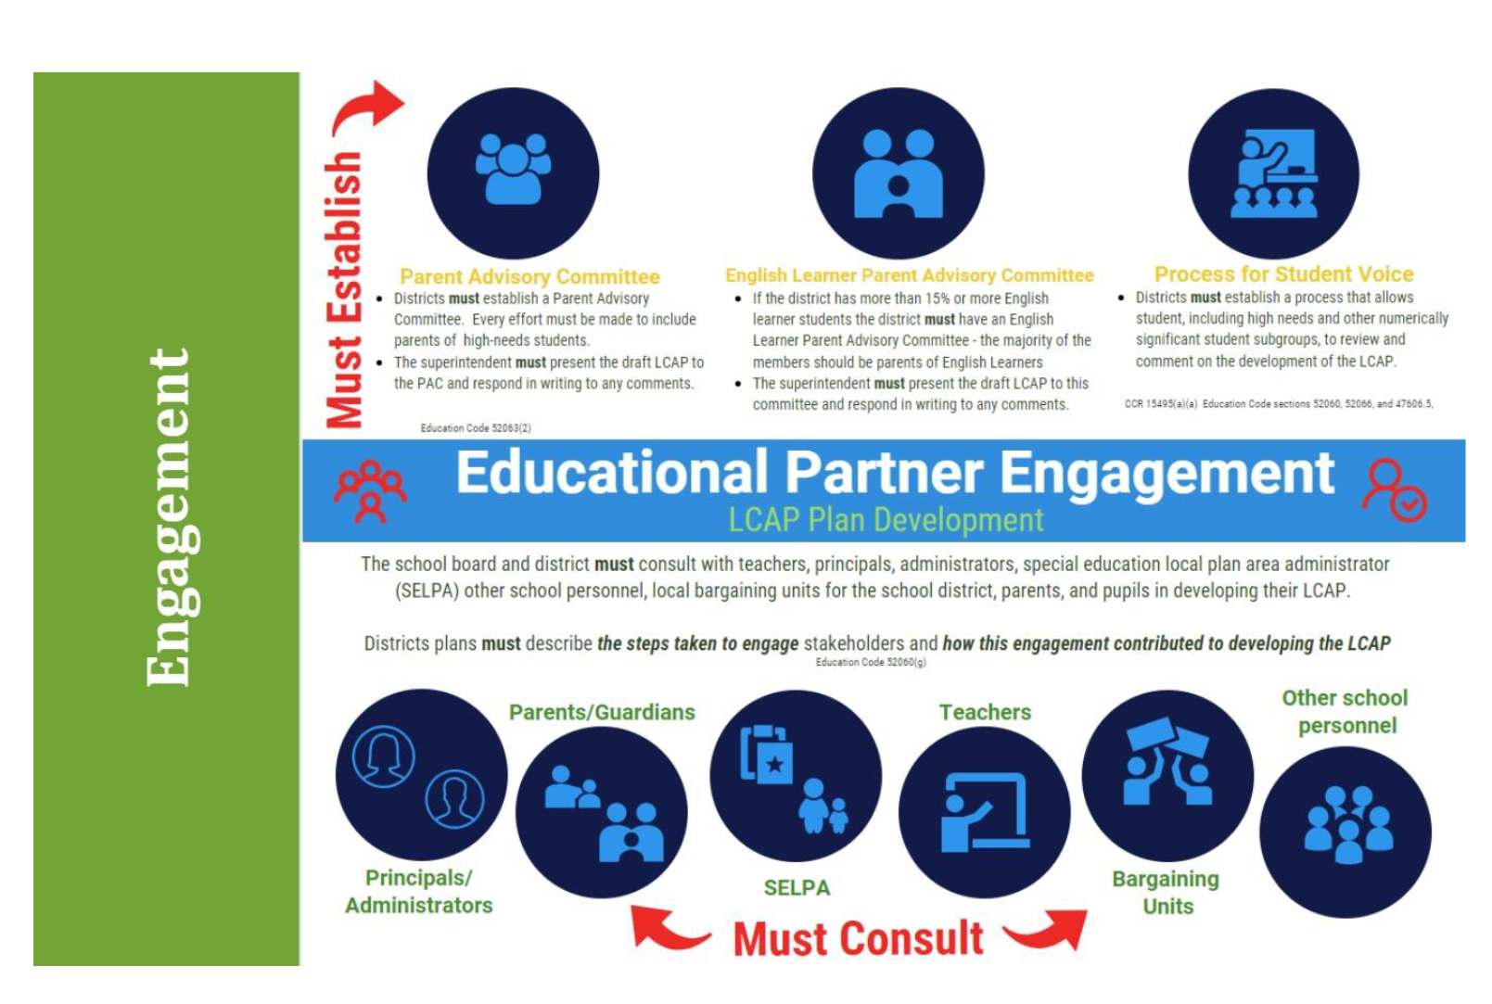
Engaging educational partners
Recent Highlights
Direct communication to Bargaining Unit Leaders
LCAP Project & District Leadership Meetings
Placed on the Student Advisory Committee agenda
Focused meeting communication

Slide 17
2023-2024 LCAP Review and Feedback survey
Now Available!!!
6 languages
English
Spanish
Tagalog
Punjabi
Khmer Cambodian
Hmong

Slide 18
Mid-Year Update
DECISIONS MADE TODAY
ARE WHAT IS BEST
FOR KIDS TO IMPROVE
EDUCATIONAL OUTCOMES
Supporting Resources
Mid-Year LCAP Update – February 28
LCAP Federal Addendum – June 30
Notes:
Courageous conversations around data, existing programs…hard decisions that will influence or have an impact on existing programs…whether activities or funding adjust. (upcoming conversation)

Slide 19
What is a mid-year update
A communication tool (resource) to inform educational partners with the status of the district’s implementation of actions, meeting metrics, and expending funds.
Informational
Present at regularly scheduled board meeting
Deadline: no later than February 28

Slide 20
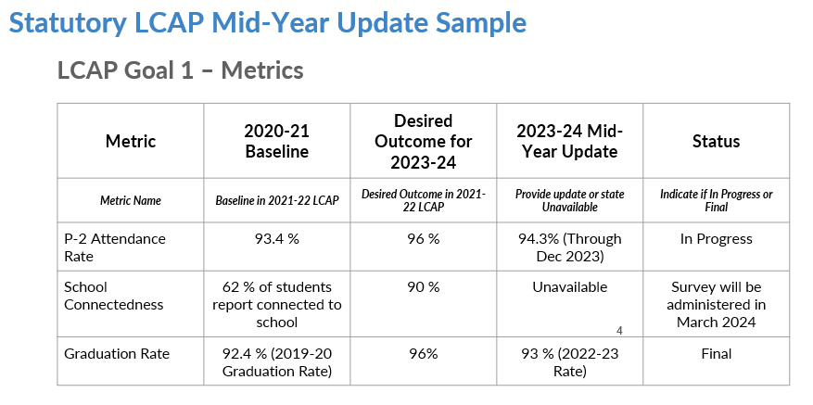
Expected annual measurable objectives
Metric Status Reporting
Unknown
In Progress
Known
Data Availability
Metric data may not be available at the time of completing the Mid-Year Update. A note will be made in the applicable field.

Slide 21
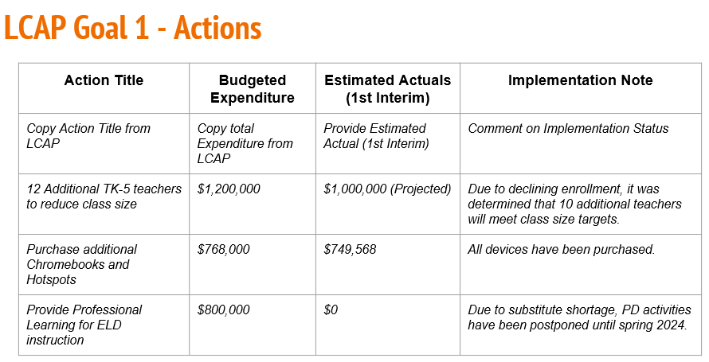
Action outcomes and implementation
Outcome and Implementation
Status Reporting
Not Started
In Progress
Completed
Project Status
Project Leads are actively compiling data, both narrative and artifacts supporting implementation. Deadline for Project Leads to provide information is January 31, 2024.

Slide 22
expenditures
Expenditure Reporting
Not Started
In Progress
Completed
Expenditure Status
Business Services and State & Federal Programs are reviewing expenditures identified in the district’s financial system.

Slide 23
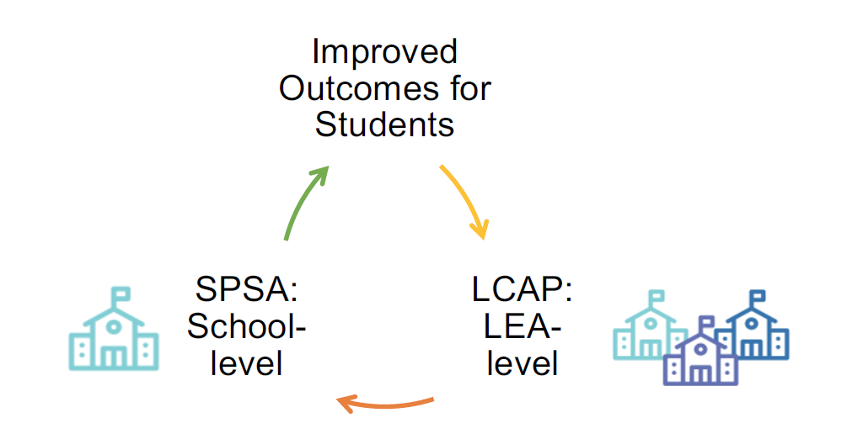
Funding overview

Slide 24
Budget overview for parents (BOP)
Short but Informative
Summarizes high level financial information
District revenue and expenditure amounts are gathered from Form 01
LCAP Action tables provide prior year and current LCFF amounts

Slide 25
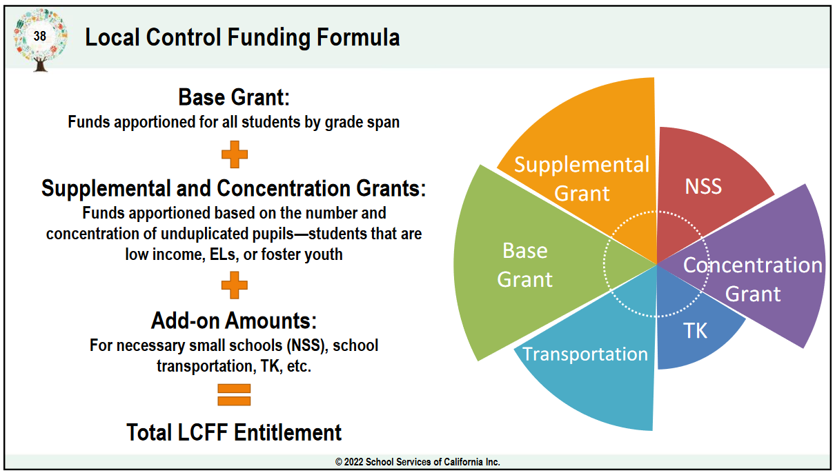
LOCAL Control funding formula (LCFF)
Background
Effective 2013
Focusing on needs of students
Funding decisions moved to the local (district) level
Eliminated and lifted many categorical program restrictions
Created the LCAP
Must address the 8 State Priorities

Slide 26
2nd take at LCFF funding overview
Calculating SUSD’s LCFF
Enrollment Data from CALPADS
Unduplicated Pupil Count Data from CALPADS
Per Student Base
Grade Span Adjustment
SJCOE calculates preliminary LCFF amounts in January/February and a finalizes in May after the Governor's May Revise budget release

Slide 27
Hypothetical example and Interactive ACTIVITY
How Would You Prioritize?
BASE:
$50,000
SUPPLEMENTAL & CONCENTRATION:
$7,500
CONCENTRATION 2.0:
$5,000

Slide 28
Base grant
SUSD’s Basic and Core Needs:
General education teaching staff
Clerical support staff for school sites,
Formulaic "base" staffing
Central support staff
General supplies
Utilities
Facilities, grounds, maintenance, repairs, and other basic operational functions
Personal Basic and Core Needs:
Housing
Car (and Insurance)
Food
Childcare
Electricity/Gas
Water
Garbage
Cellphone
Internet
Cable (Basic local stations)
Interactive Activity
Question 1:
What are YOUR basic and core NEEDS?
Question 2:
Are there any NEEDS not on the list? If so, why did you prioritize it as a basic and core NEED?

Slide 29
Supplemental and concentration grant
Supplemental Funds equal 20% of the Adjusted Base Grant generated for each student identified as foster youth, English learner or low income
Concentration Funds equal 65% of the Adjusted Base Grant generated when student identified as foster youth, English learner or low income comprise more than 55% or more of the district enrollment, generated for each student above that threshold
SJCOE calculates preliminary LCFF amounts in January/February and a finalizes in May after the Governor's May Revise budget release

Slide 30
Supplement and concentration grant
SUSD’s Wants:
Tutoring
Intervention Programs
Bilingual supports & staff
Arts programming
Field Trips/Science Camp
Student Clubs
Technology
Career Pathways
College Visits
Social Emotional supports
Personal Wants:
Luxury Housing
Luxury Car (and Insurance)
Dining/Restaurants
Movies
Toys
Disney+/HBO/DirectTV
Camping/Staycation
Video Games/V-Bucks
Hair/Nails/Salon Treatments
Student Activities (Prom)
Interactive Activity
Question 1:
What are YOUR WANTS?
Question 2:
Are there any WANTS not on the list? If so, why did you prioritize it as a WANT?

Slide 31
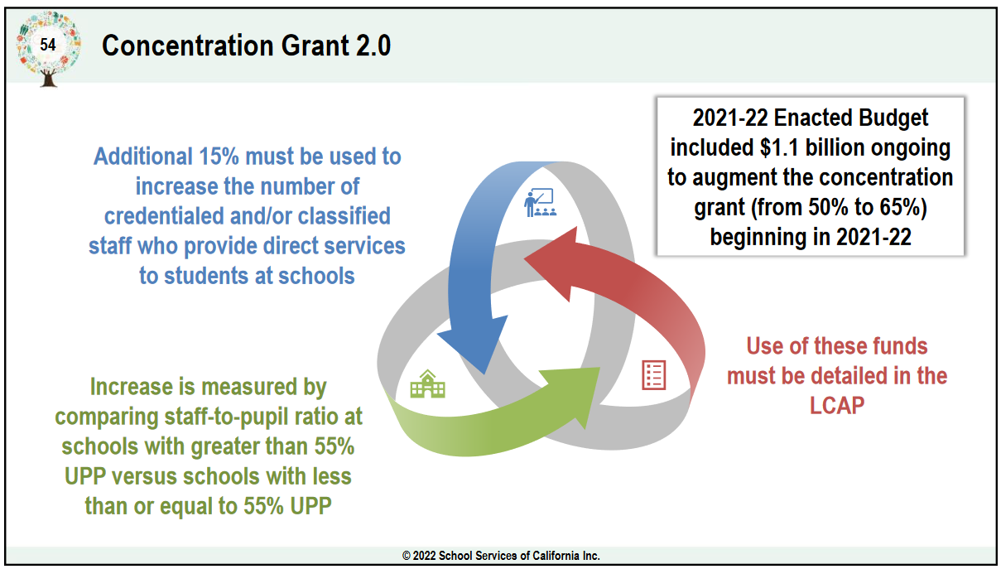
Concentration grant 2.0 (15% Add on)
Specific Staff Support
Student Support Technicians
Bilingual Assistants
Library Media Assistants
School Psychologist
Custodians
Descriptions of how direct support personnel were identified in located in the 23-24 LCAP on page 218.
SJCOE calculates preliminary LCFF amounts in January/February and a finalizes in May after the Governor's May Revise budget release

Slide 32
concentration grant 2.0
SUSD’s “extra” Wants:
Student Support Technicians
Bilingual Assistants
Library Media Assistants
School Psychologist
Custodians
Personal “extra” Wants:
Cruise/Disney World
Motorcycle
RV/Travel Trailer
Vacation Home/Timeshare
Boat/Jet Ski
Interactive Activity
Question 1:
What are YOUR “extra” WANTS?
Question 2:
Are there any “extra” WANTS not on the list? If so, why did you prioritize it as an “extra” WANT?

Slide 33
Equity multiplier (1)
Who Are These Sites?
The district is pending identification of school sites from the CDE.

Slide 34
Equity multiplier (2)
Future Information
SUSD will provide more details of identified schools and obtain feedback from Interest Holders (aka Educational Partners).

Slide 35
Next lcap engagement session
FOCUSED TOPIC:
Data Analysis / District Areas of Need
DATE:
February 9, 2024
TIME:
9:00 a.m. – 10:30 a.m. – Zoom (https://us06web.zoom.us/j/88016804412)
5:30 p.m. – 7:00 p.m. – In Person @ Madison Elementary

Slide 36
LCAP Engagement in 2023-2024
11/28: Introduction: LCAP Fundamentals
12/04: Current District Priorities – 2023-2024 School Year
01/19: LCAP Mid-Year Update and Funding
02/09: Data Analysis / District Areas of Need
02/19: Budget Projections
03/05: Survey Results and Key Findings
03/08: Identified District Goals/Activities
* April 2024: Post Draft 2024-2027 LCAP
* May 2024: Public Hearing 2024-2027 LCAP
* June 2024: Board Adoption 2024-2027 LCAP

Slide 37
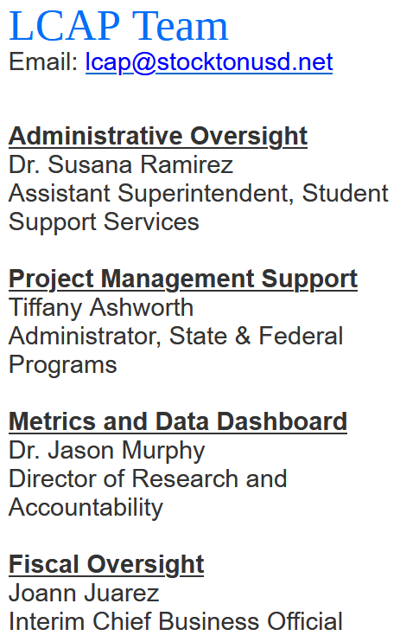
THANK YOU!

